Slide 1


Slide 2


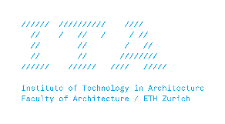


MAS Digital Fabrication
Digital Architecture
Implicit modelling

Slide 3
Basic concepts
edge
vertex
face
quad
triangle
Notes:
Vertex connected to each other with edges

Slide 4
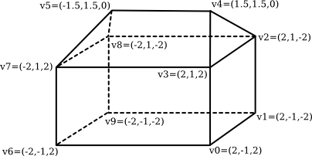
Vertices.. Faces..
Vertex #0. (2, -1, 2)
Vertex #1. (2, -1, -2)
Vertex #2. (2, 1, -2)
Vertex #3. (2, 1, 2)
Vertex #4. (1.5, 1.5, 0)
Vertex #5. (-1.5, 1.5, 0)
Vertex #6. (-2, -1, 2)
Vertex #7. (-2, 1, 2)
Vertex #8. (-2, 1, -2)
Vertex #9. (-2, -1, -2)
Face #0: (0, 1, 2, 3)
Face #1: (3, 2, 4)
Face #2: (7, 3, 4, 5)
Face #3: (2, 8, 5, 4)
Face #4: (5, 8, 7)
Face #5: (0, 3, 7, 6)
Face #6: (0, 6, 9, 1)
Face #7: (2, 1, 9, 8)
Face #8: (6, 7, 8, 9)
Notes:
an ordered array of vertices, and a list of faces

Slide 5
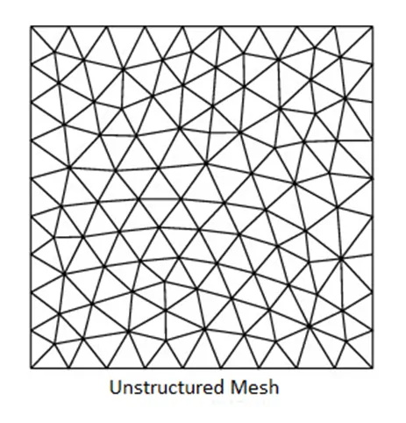
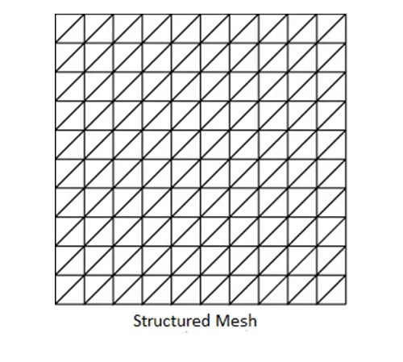

Slide 6
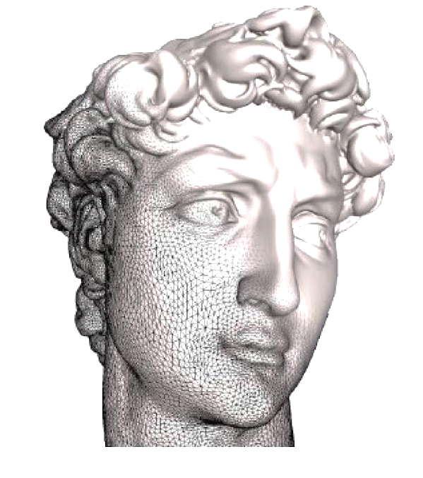
Boundary representation
Notes:
Limits or boundaries. Discrete set of facets

Slide 7
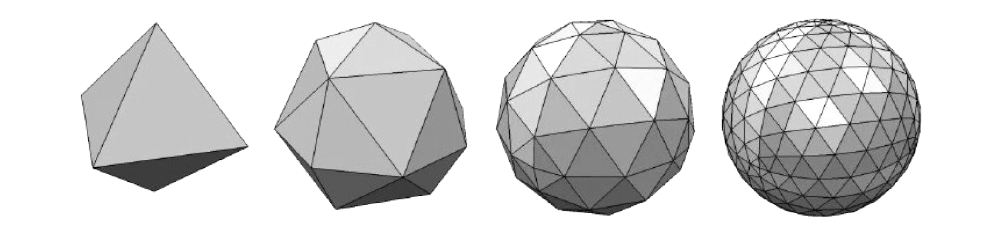
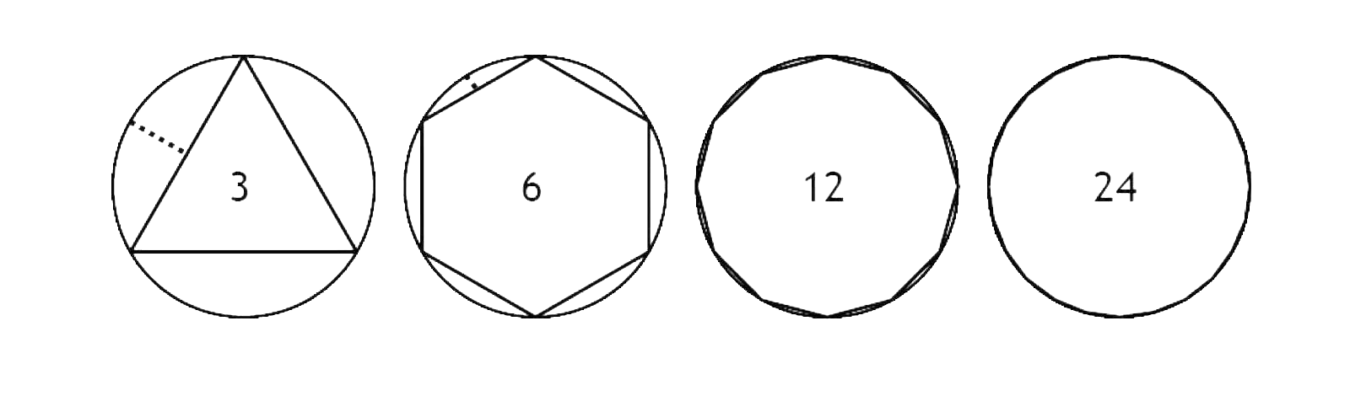
Resolution
Notes:
It’s always an approximation of the shape that depends on the resolution, how many faces we use to represent the shape

Slide 8
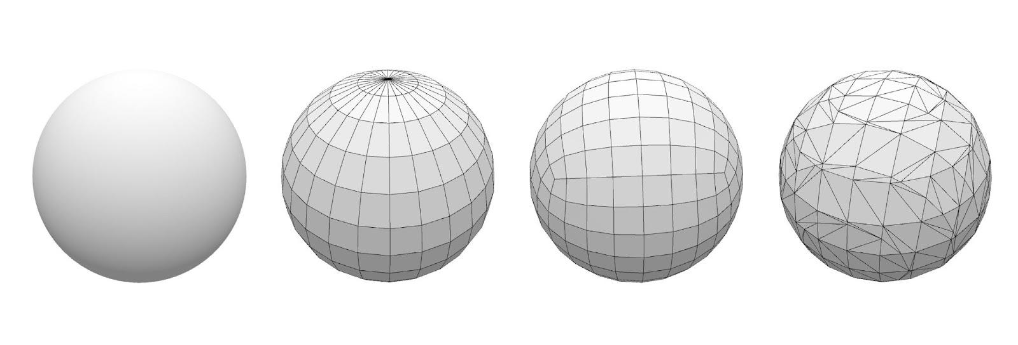
A sphere is a sphere

Slide 9
mesh subdivision

Slide 10
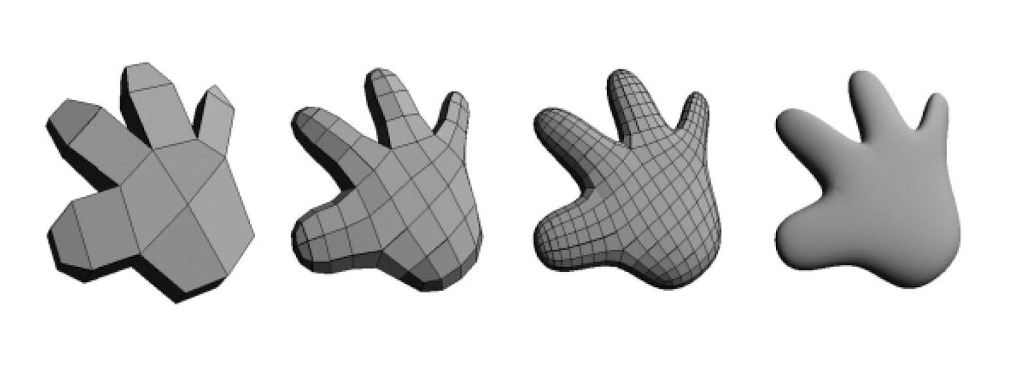
Catmull-Clark
Notes:
Catmull and other researchers developed strategies to create smooth geometry from a coarse mesh for animation

Slide 11
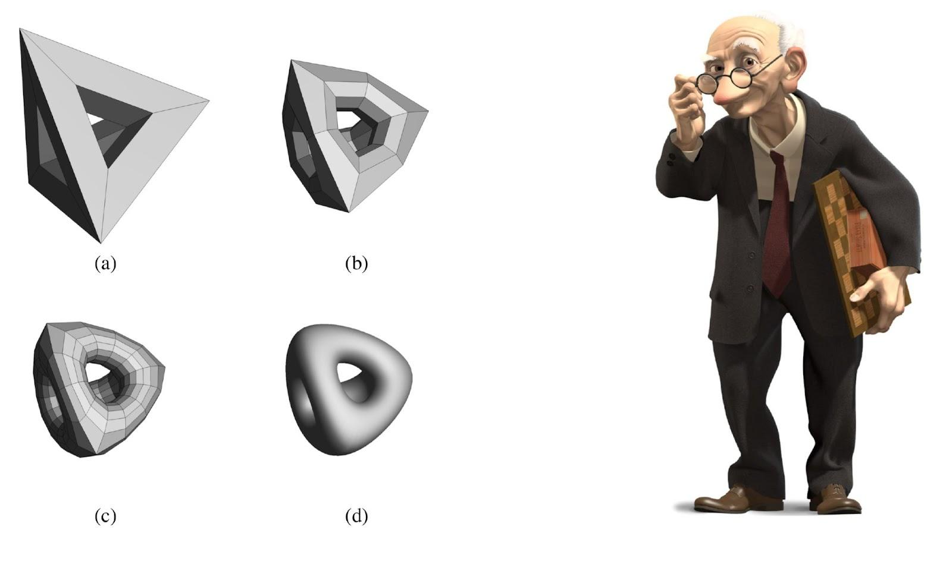
Subdivision Surfaces in Character Animation
Notes:
Character from Geri's Game: animation movie won academy award - Rhino 7 Subdi
https://www.youtube.com/watch?v=9IYRC7g2ICg&ab_channel=WorldFilmChannel

Slide 12
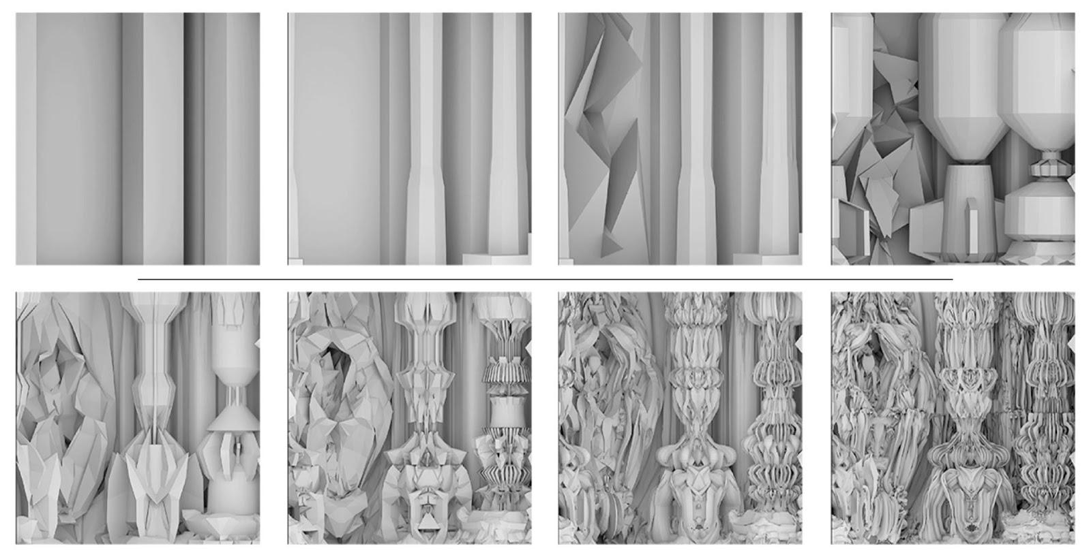
Digital Grotesque, Hansmeyer/Dillenburger
Notes:
Not replace the geometry with a further smoother geometry but a more articulated one

Slide 13
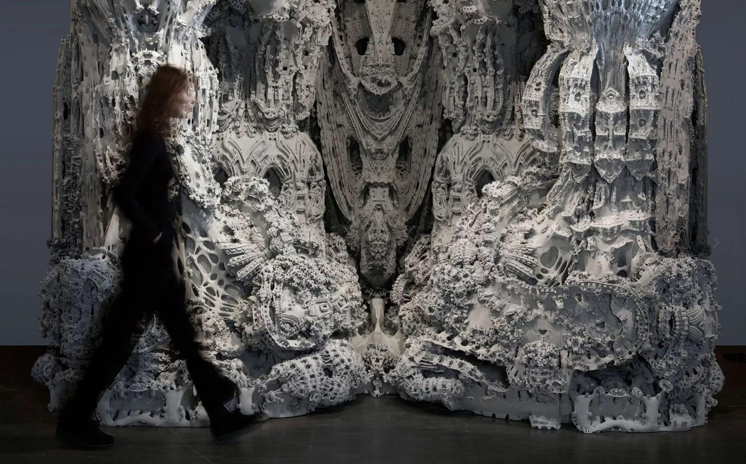
Digital Grotesque, Hansmeyer/Dillenburger
Notes:
Difference between explicit and implicit modeling (this example could never be possible to create manually)

Slide 14
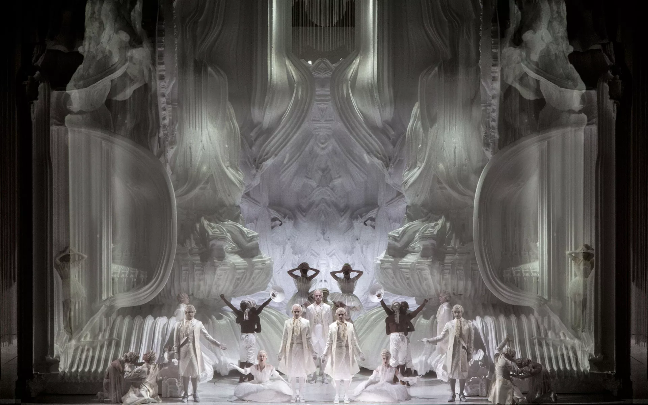
Grotto set design for Mozart's Magic Flute, directed by Romeo Castellucci

Slide 15
slab?

Slide 16
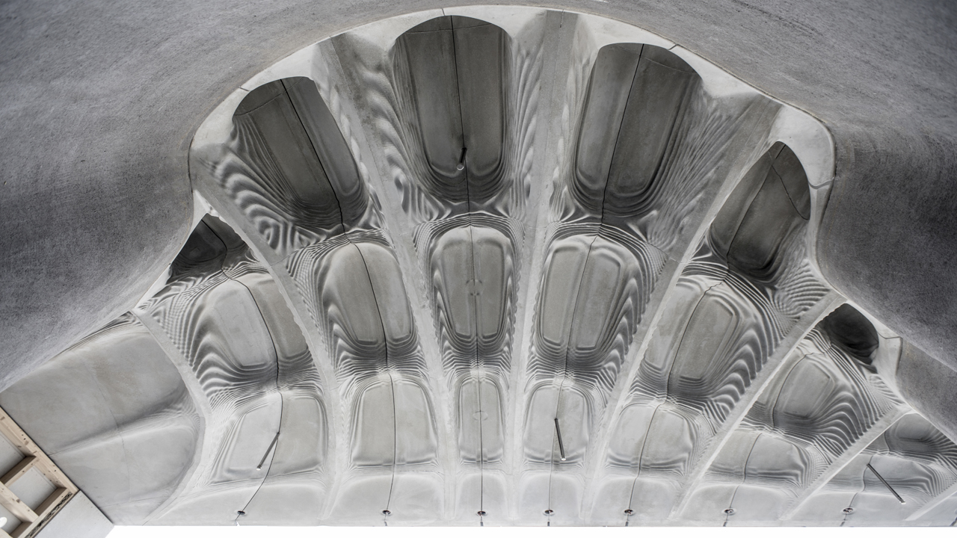
Smart Slab, 2018

Slide 17
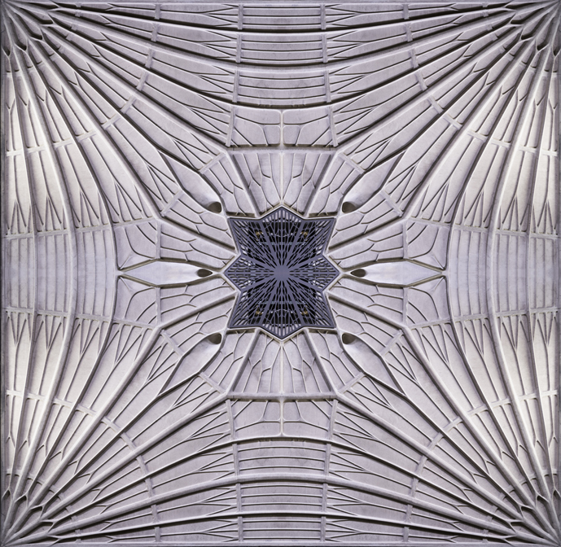
Functional Formwork, 2019

Slide 18
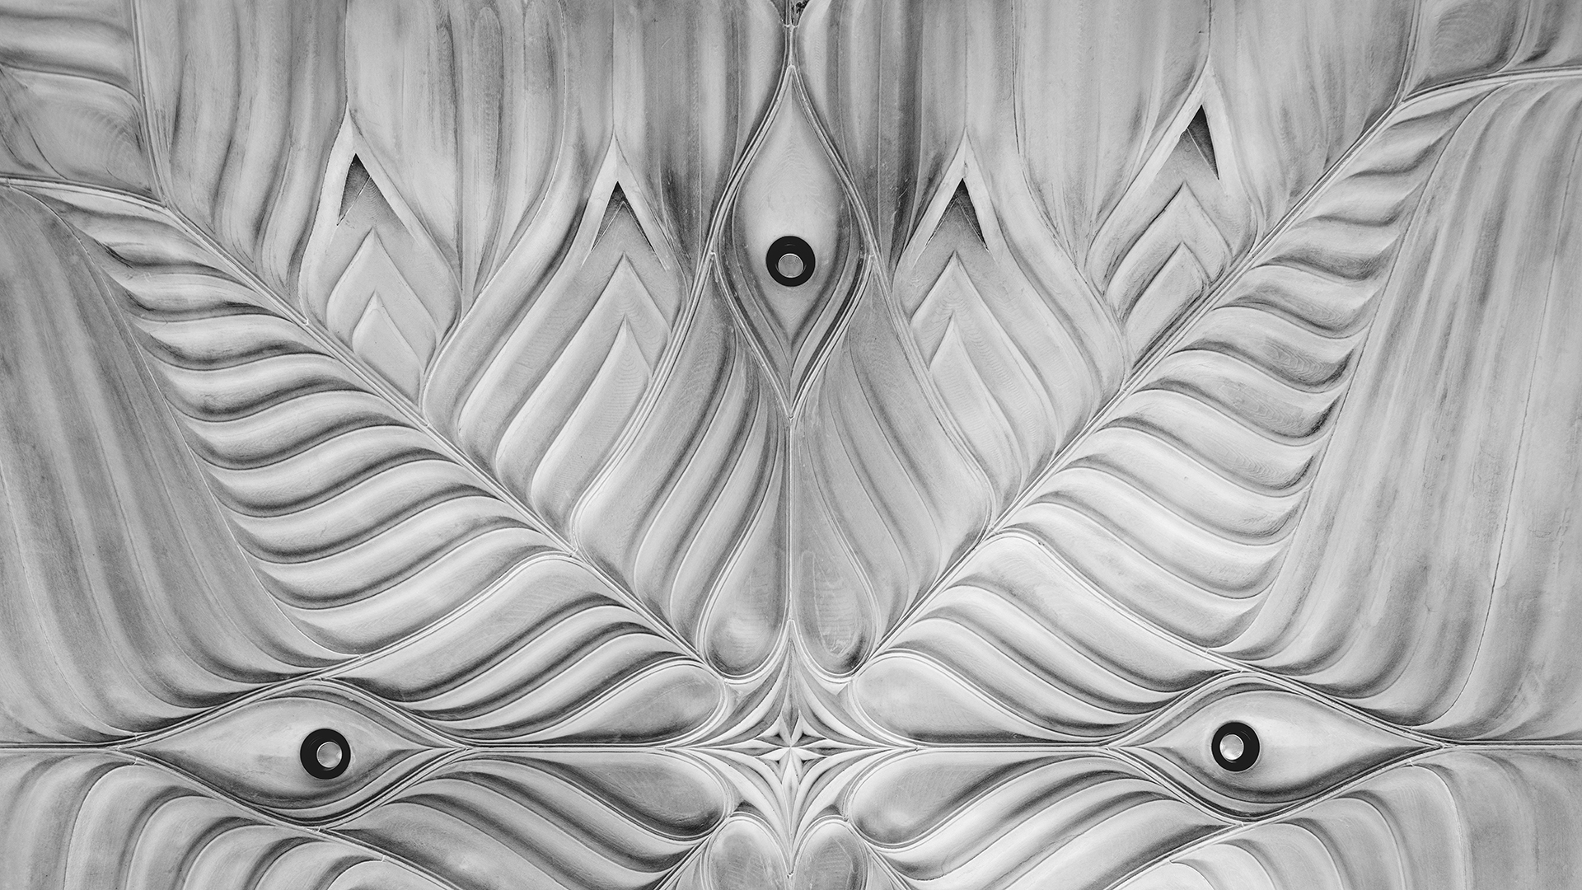
HiRes Concrete, 2021

Slide 19
column?

Slide 20
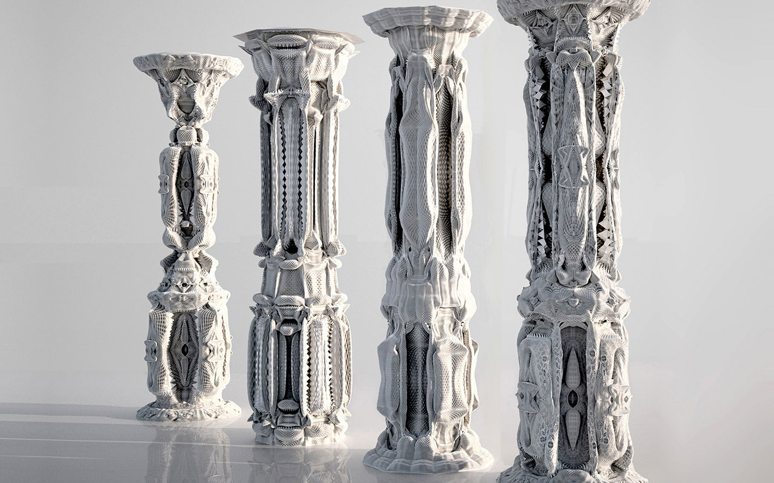
Michael Hansmeyer 2010, Subdivided Columns
Notes:
https://vimeo.com/86517706

Slide 21
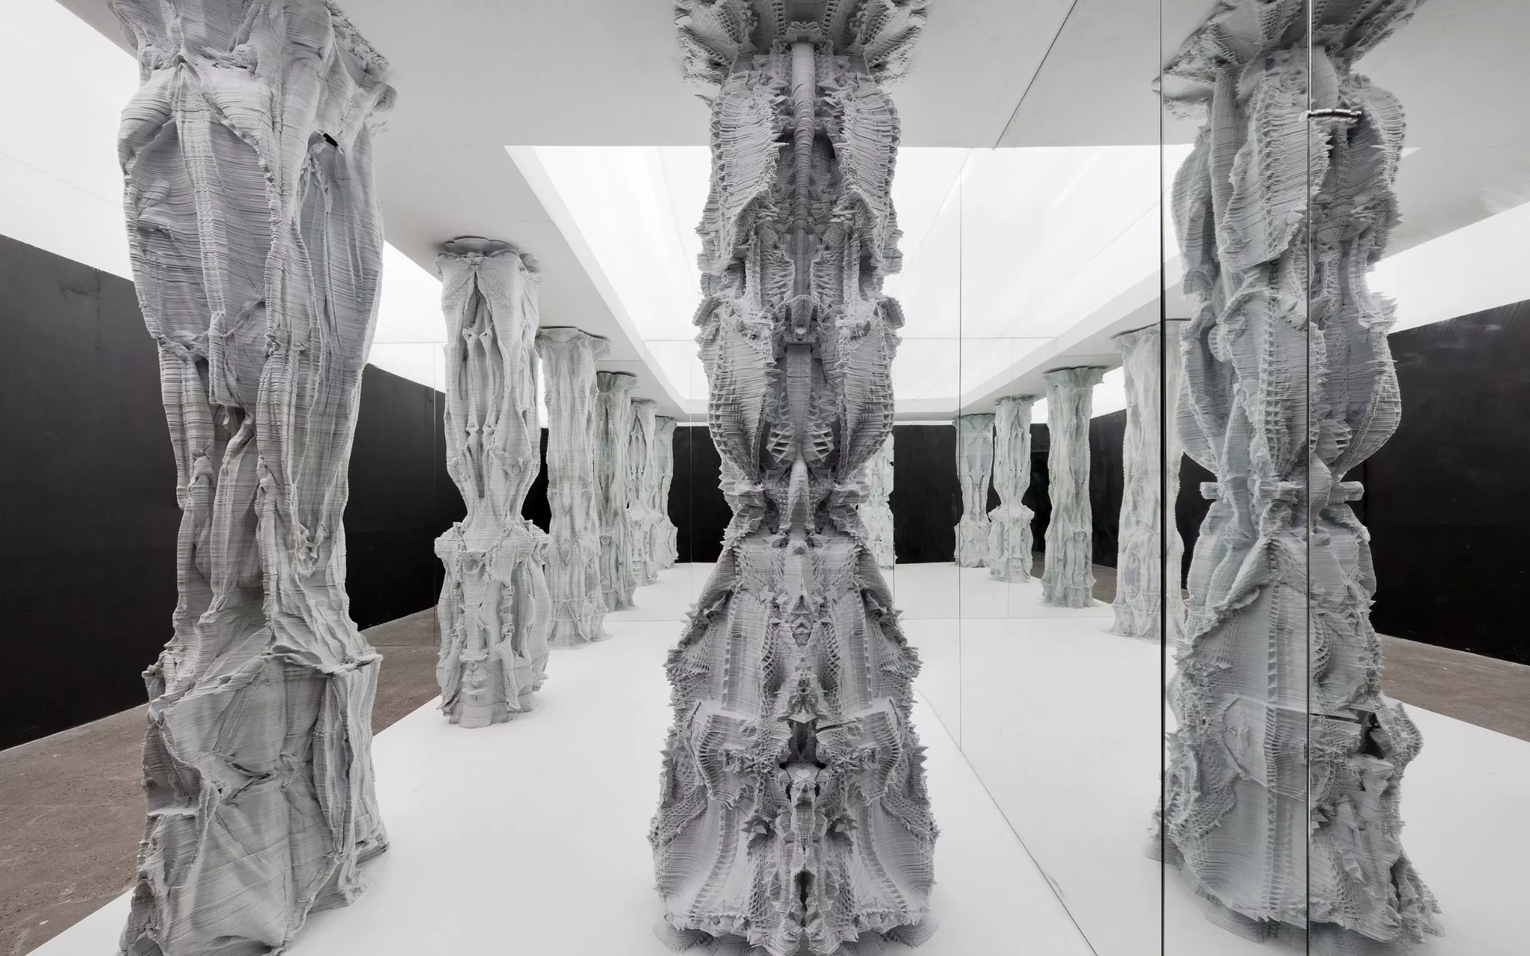
Sixth Order: Gwangju Design Biennale 2011

Slide 22
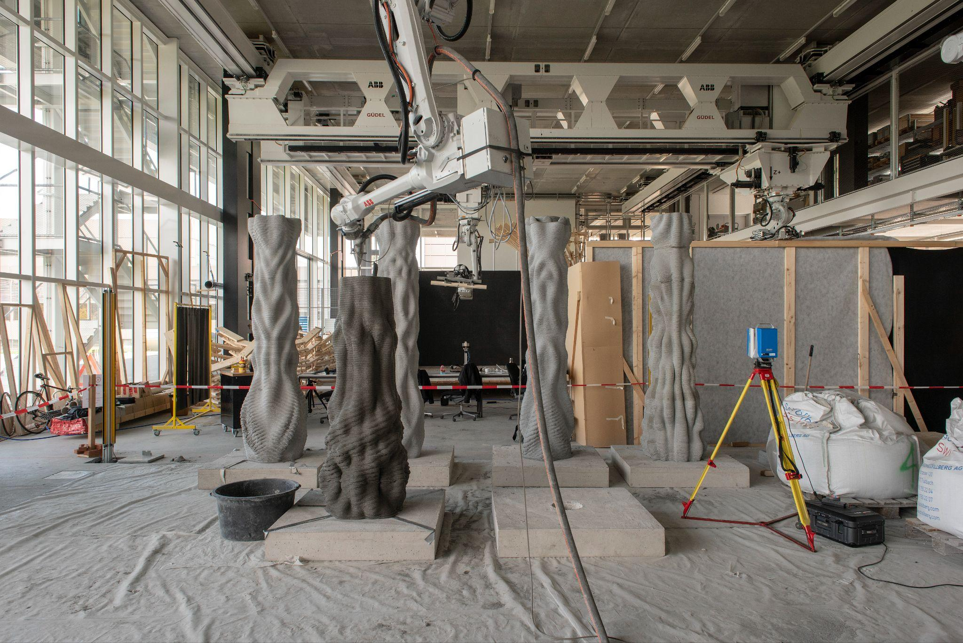
Concrete Choreography, 2018

Slide 23
use mesh subdivision...

Slide 24
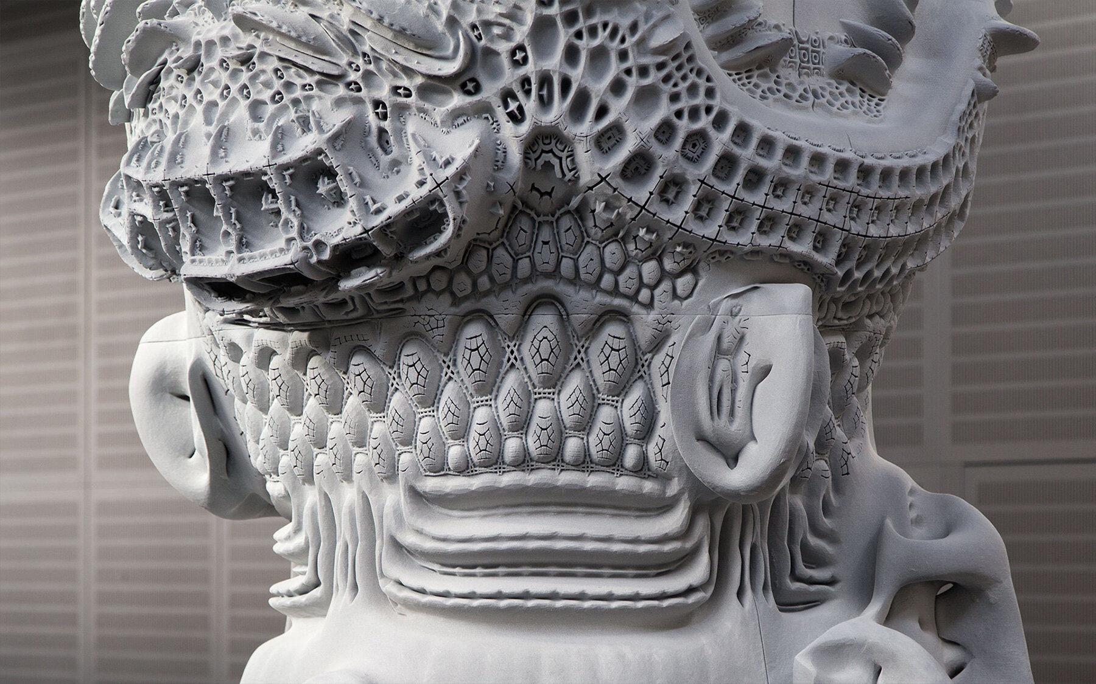
Digital Grotesque III

Slide 25
immersive computational architecture

Slide 26
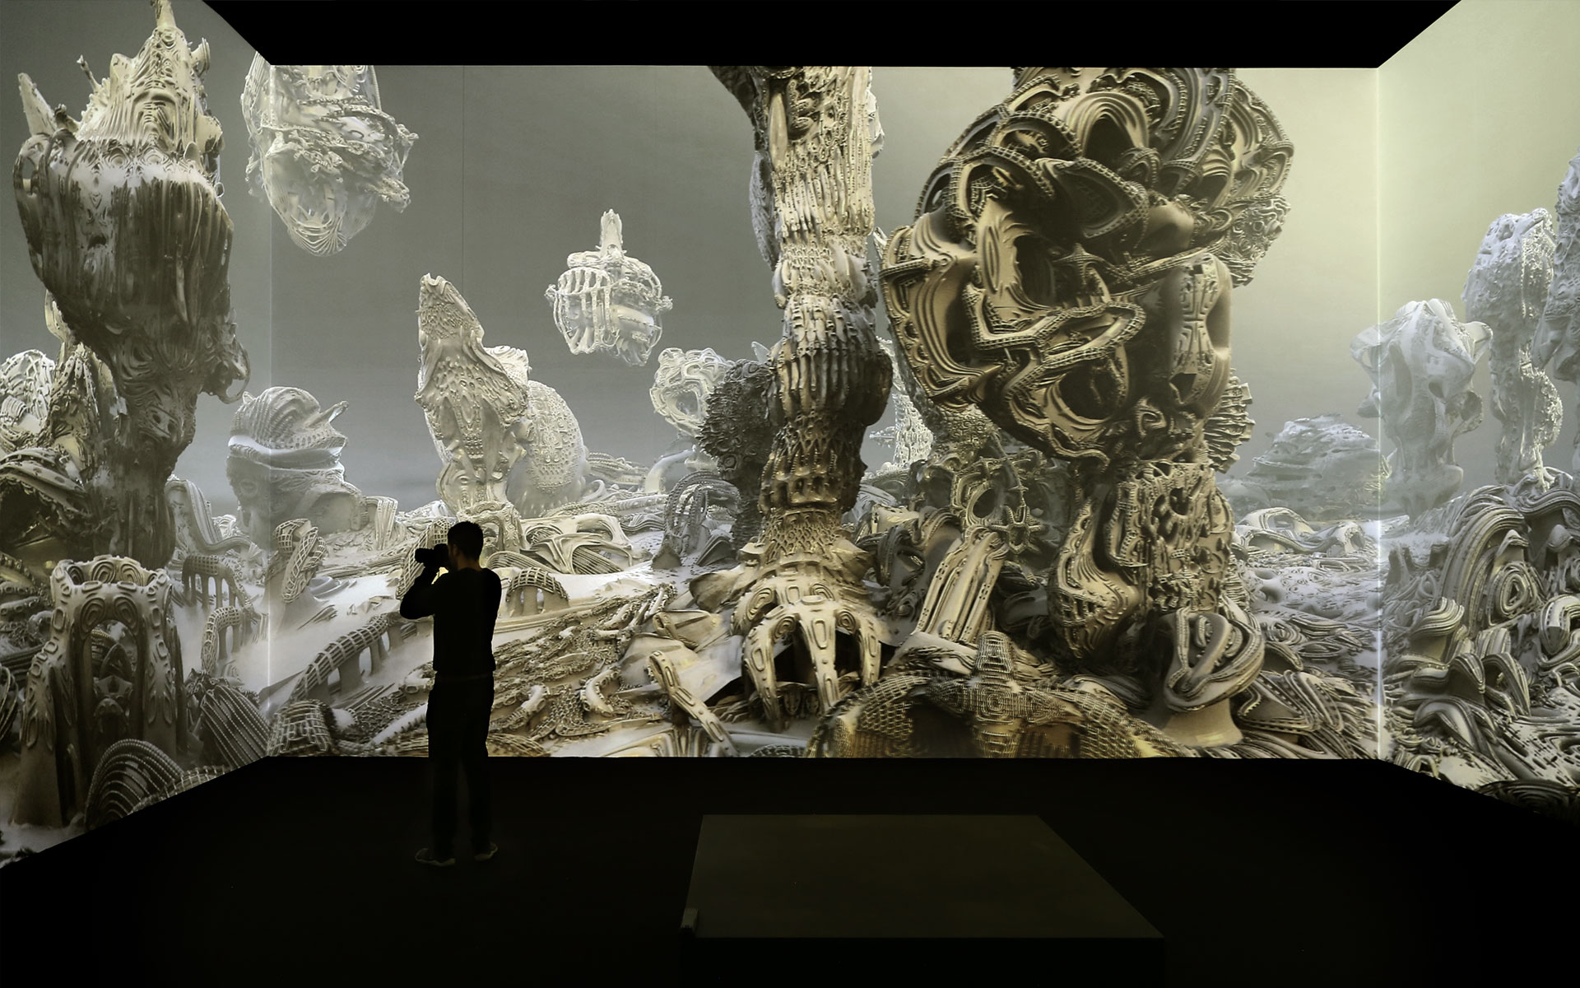
Digital Grotesque III
Notes:
https://player.vimeo.com/video/762579933?h=0d89b9eca3

Slide 27
SUBMISSION
GROUPS
7 groups of 2 students
CONTENT
Design of slab/column/slab and column(s)
Use algorithmic strategy for mesh subdivision
Presentation with real-time render in RADii
TOOLS
Python in Rhino/Grasshopper
Mola
ParaSub
RADii

Slide 28
what is a mesh ?

Slide 29
Basic concepts
edge
vertex
face
quad
triangle
Notes:
Vertex connected to each other with edges

Slide 30
Vertices.. Faces..
Vertex #0. (2, -1, 2)
Vertex #1. (2, -1, -2)
Vertex #2. (2, 1, -2)
Vertex #3. (2, 1, 2)
Vertex #4. (1.5, 1.5, 0)
Vertex #5. (-1.5, 1.5, 0)
Vertex #6. (-2, -1, 2)
Vertex #7. (-2, 1, 2)
Vertex #8. (-2, 1, -2)
Vertex #9. (-2, -1, -2)
Face #0: (0, 1, 2, 3)
Face #1: (3, 2, 4)
Face #2: (7, 3, 4, 5)
Face #3: (2, 8, 5, 4)
Face #4: (5, 8, 7)
Face #5: (0, 3, 7, 6)
Face #6: (0, 6, 9, 1)
Face #7: (2, 1, 9, 8)
Face #8: (6, 7, 8, 9)
Notes:
an ordered array of vertices, and a list of faces

Slide 31
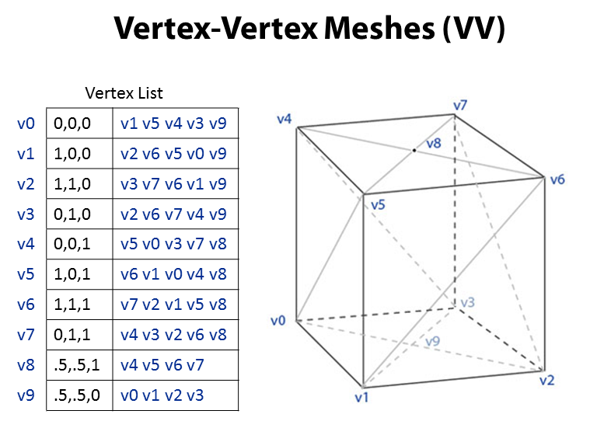
different data-structures for different tasks
Notes:
Stores vertices and connected vertices

Slide 32
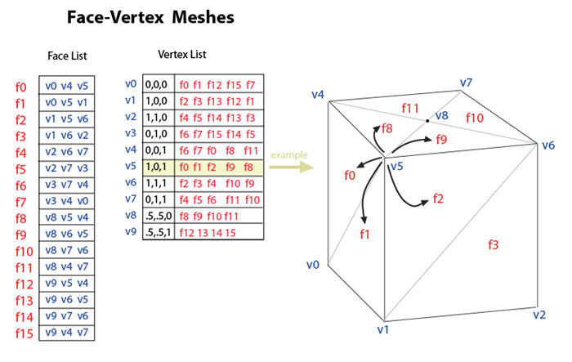
Polygon Soup
Notes:
Different Data-structures for different tasks

Slide 33
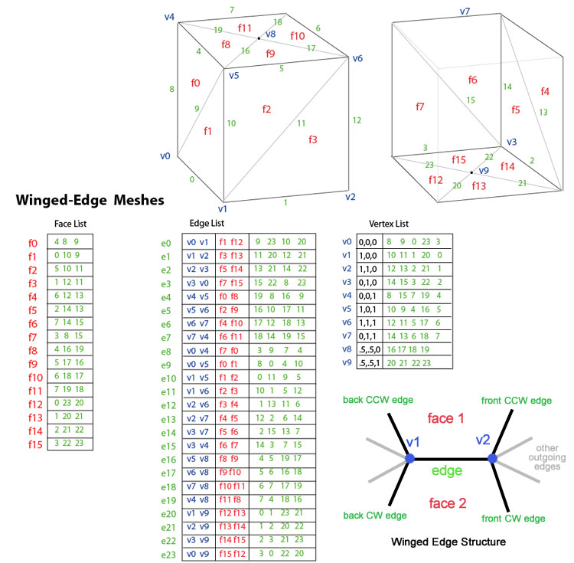
Winged Edge

Slide 34
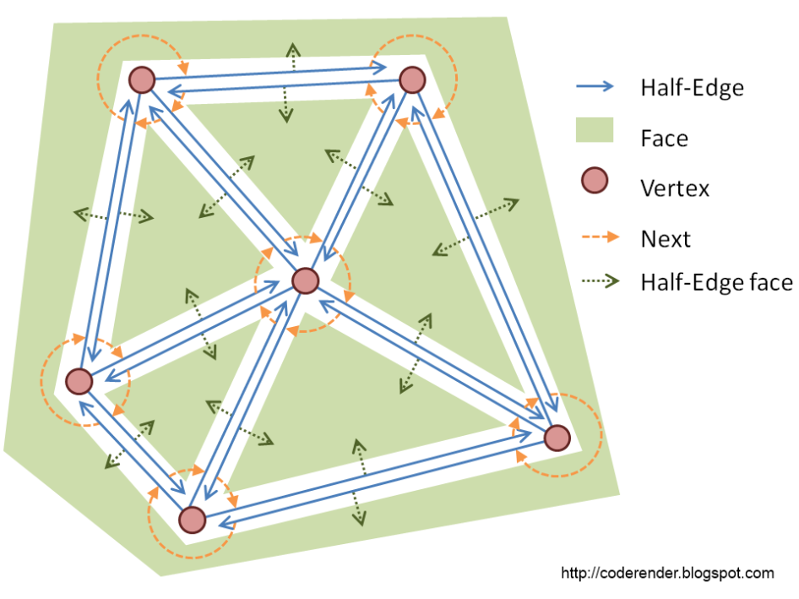
Half Edge

Slide 35
Procedural Design

Slide 36
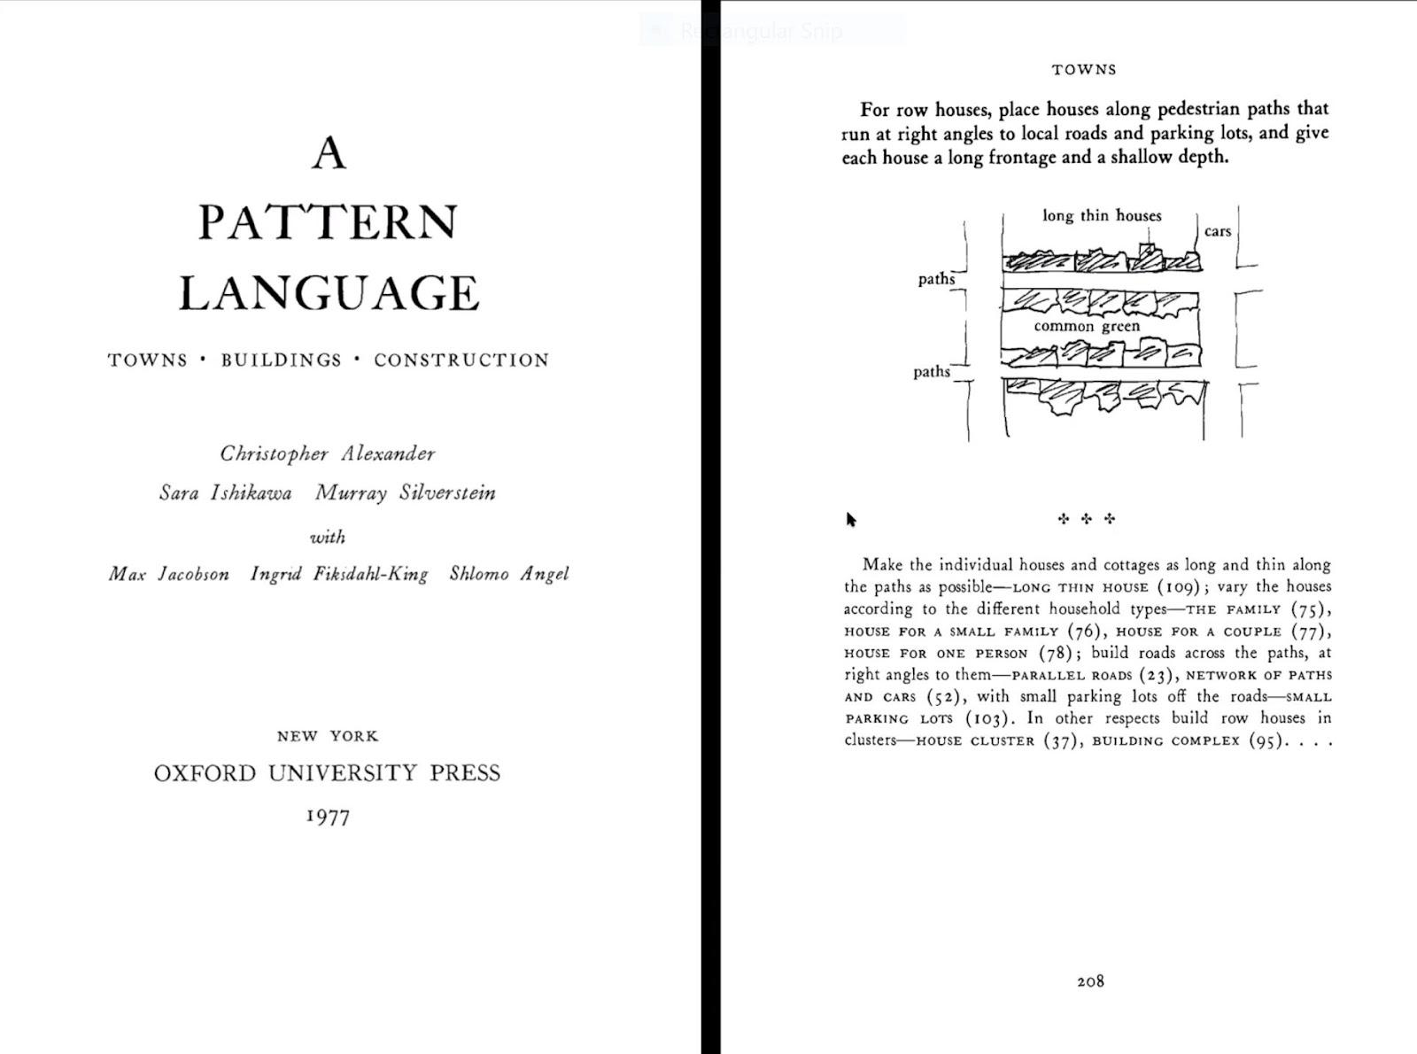
Christopher Alexander, Pattern Language
Notes:
70’s : without computers, he created a system of guidelines/of patterns on how to design. All 253 patterns together form a language .Independent pattens/rules that are connected through links to others
Here: pattern how to distribute row houses
All 253 patterns together form a language." Patterns describe a problem and then offer a solution. In doing so the authors intend to give ordinary people, not only professionals, a way to work with their neighbors to improve a town or neighborhood, design a house for themselves or work with colleagues to design an office, workshop, or public building such as a school.

Slide 37
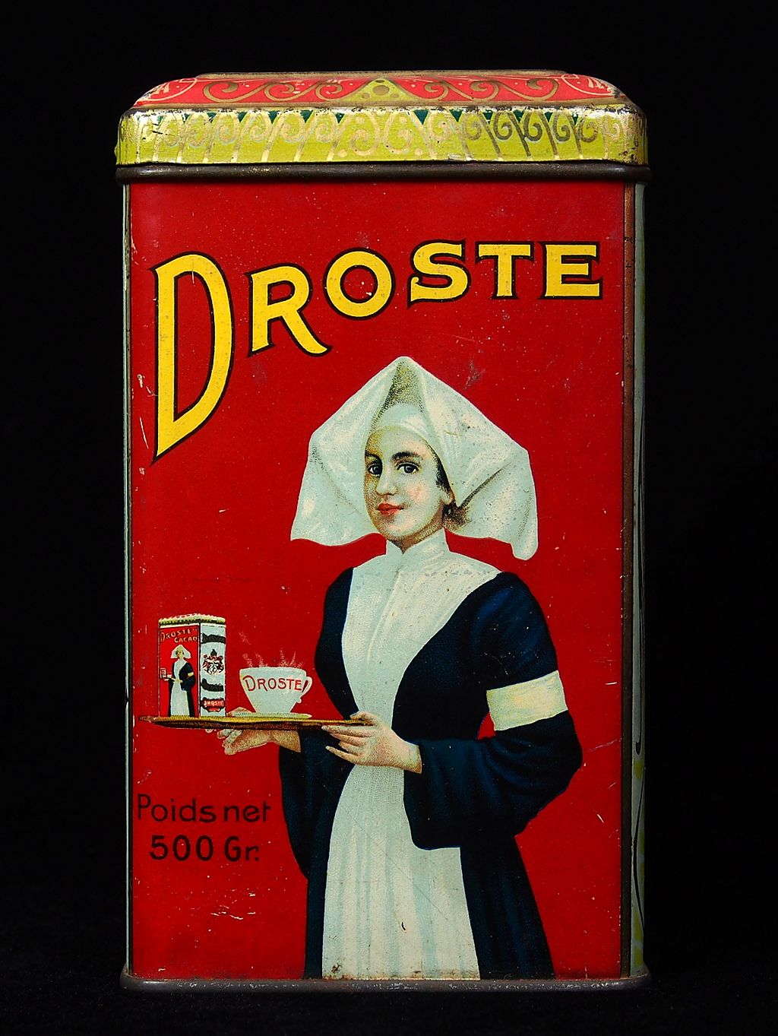
Droste effect:
A visual form of recursion
Notes:
1904 Droste cocoa tin, designed by Jan Misset.

Slide 38
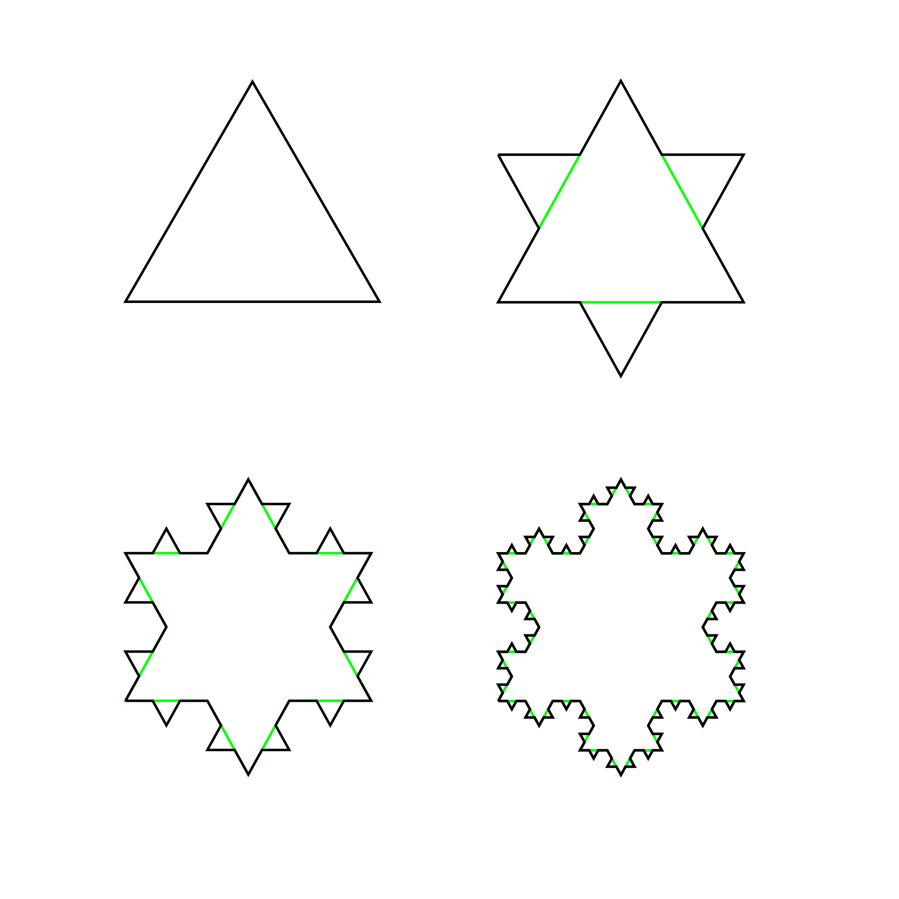
Fractals - The first four iterations of the Koch snowflake

Slide 39
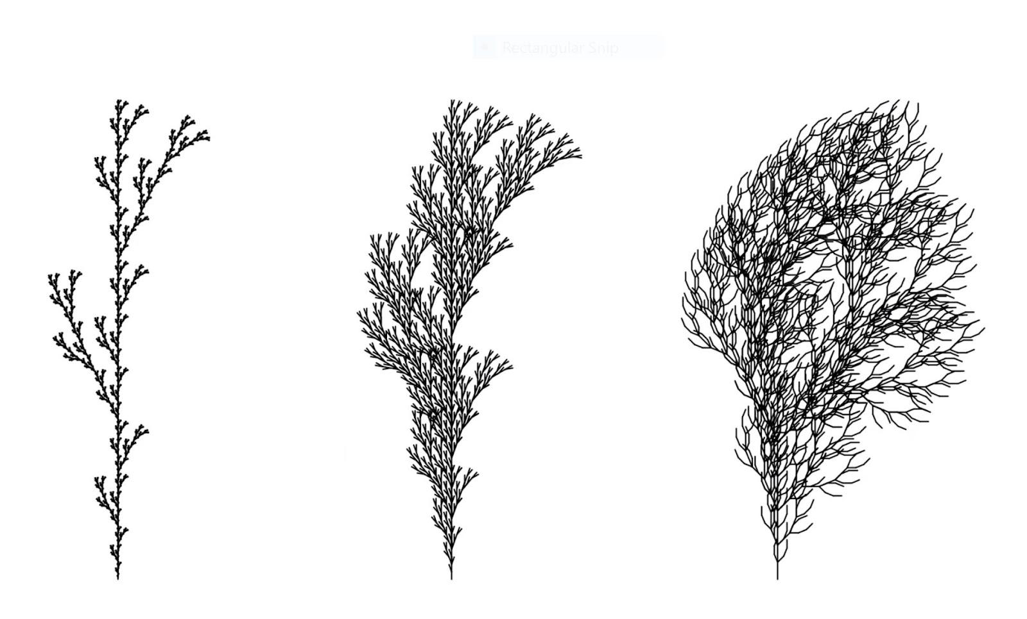
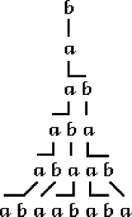
L-Systems - Lindenmayer systems
Notes:
Let’s bring it a bit closer to form and geometry..
The recursive nature of the L-system rules leads to self-similarity and thereby, fractal-like forms are easy to describe with an L-system.
Rotation + move forward
L-systems were introduced and developed in 1968 by Aristid Lindenmayer, a Hungarian theoretical biologist and botanist at the University of Utrecht.

Slide 40
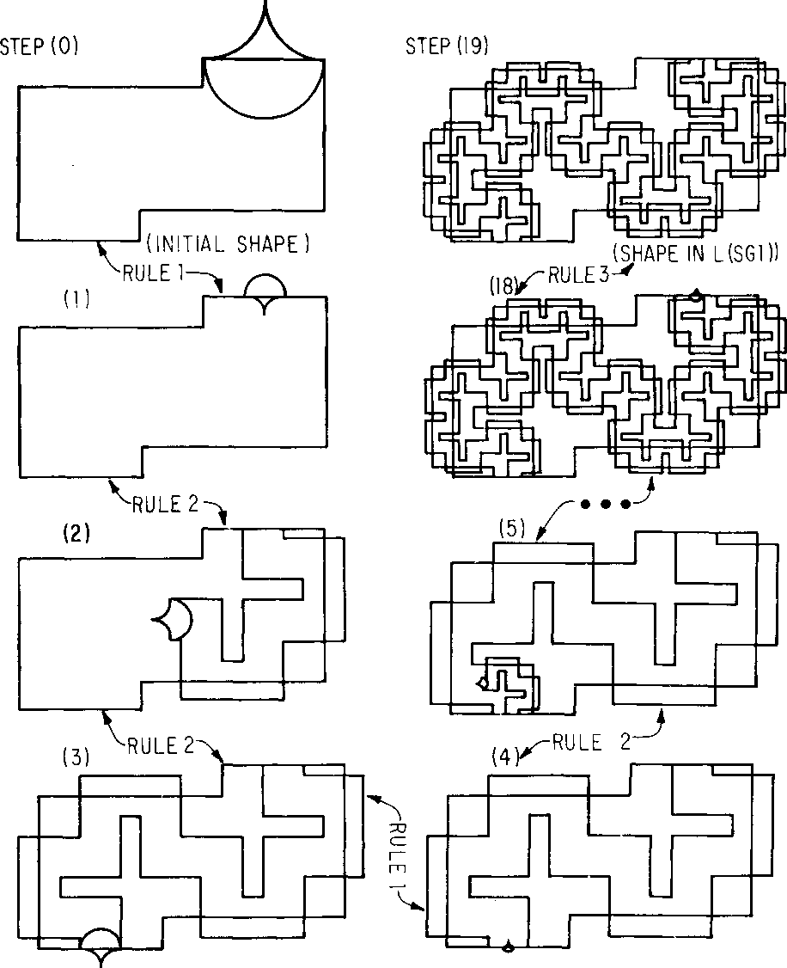
Stiny and Gips, Shape Grammars
Notes:
Later example instead of replacing characters we replace shapes

Slide 41
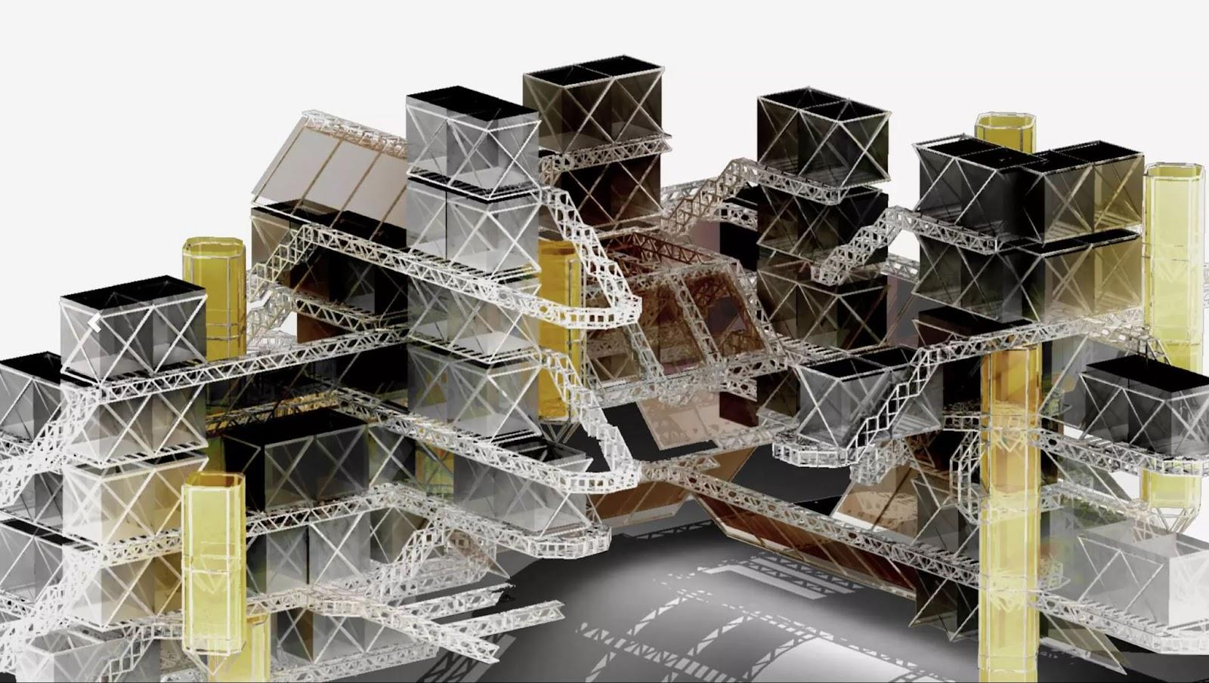
L-Systems, Hansmeyer

Slide 42
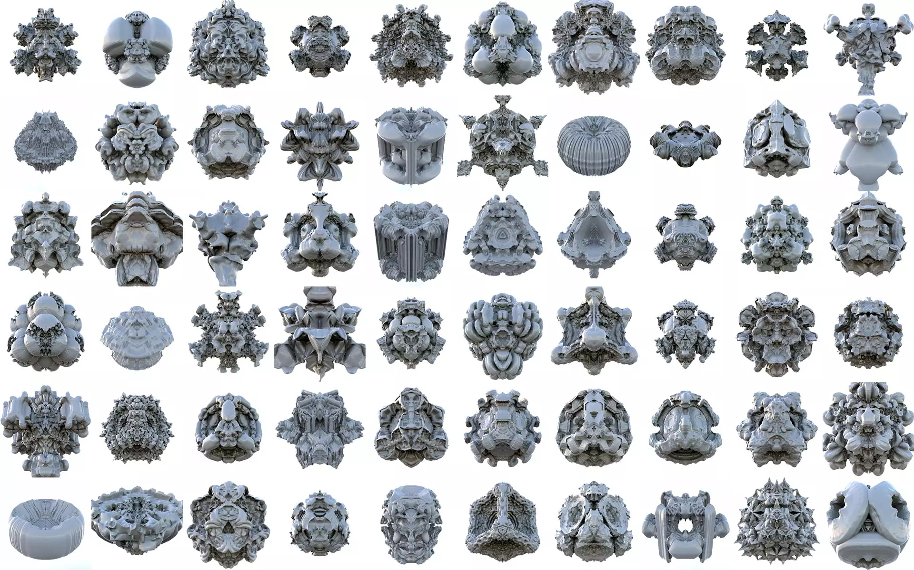
Platonic Solids, Hansmeyer

Slide 43
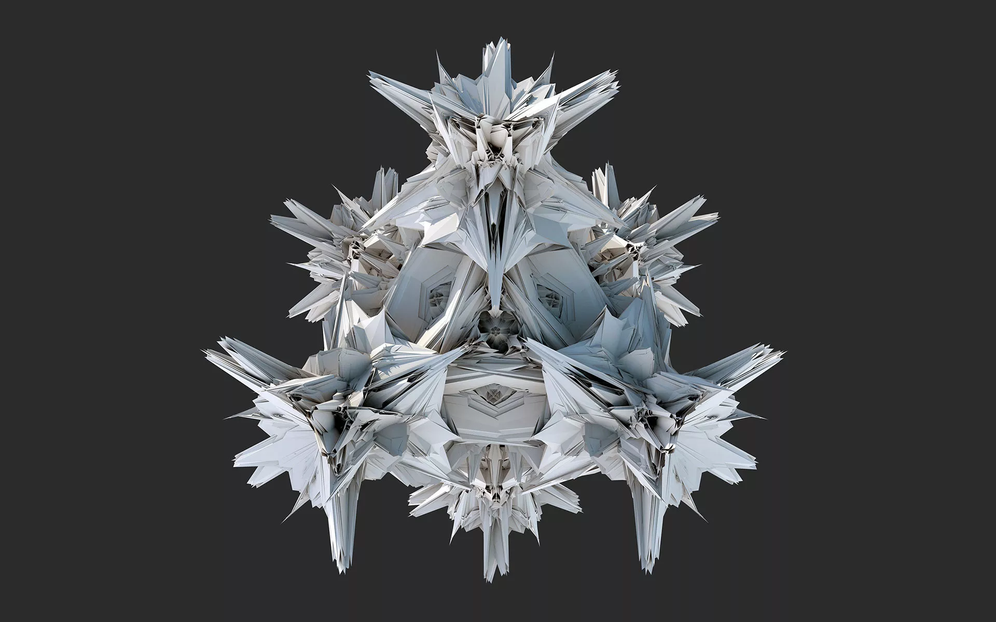

Slide 44
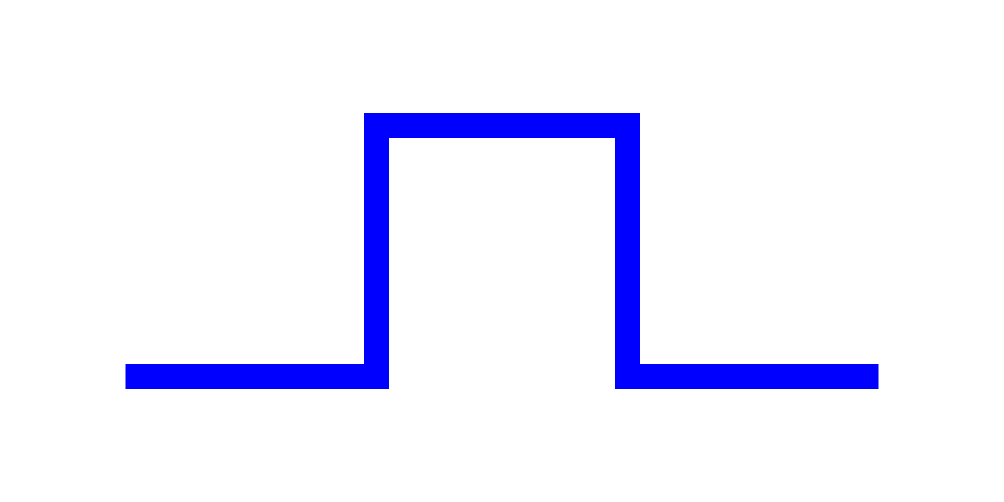
Koch curve
variables : F
constants : + −
start : F
rules : (F → F+F−F−F+F)
F + F - F - F + F
F means "draw forward"
+ means "turn left 90°"
− means "turn right 90°"

Slide 45
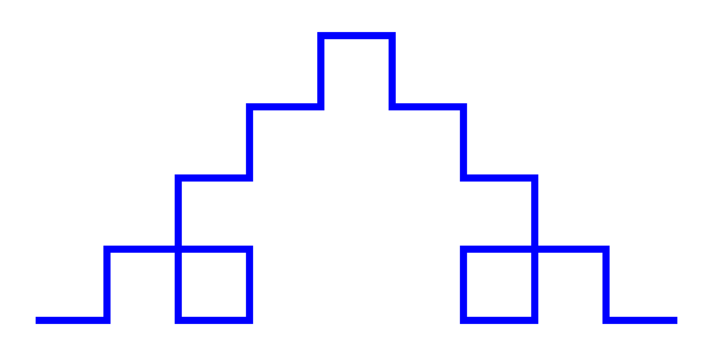
Koch curve
F + F - F - F + F
F+F-F-F+F
+
F+F-F-F+F
-
F+F-F-F+F
-
F+F-F-F+F
+
F+F-F-F+F

Slide 46
Stochastic grammars
0 → 1[0]0
to a probabilistic rule:
0 (0.5) → 1[0]0
0 (0.5) → 0
Context sensitive grammars
b < a > c → aa
transforms "a" to "aa", but only if the "a" occurs between a "b" and a "c" in the input string:
…bac…

Slide 47
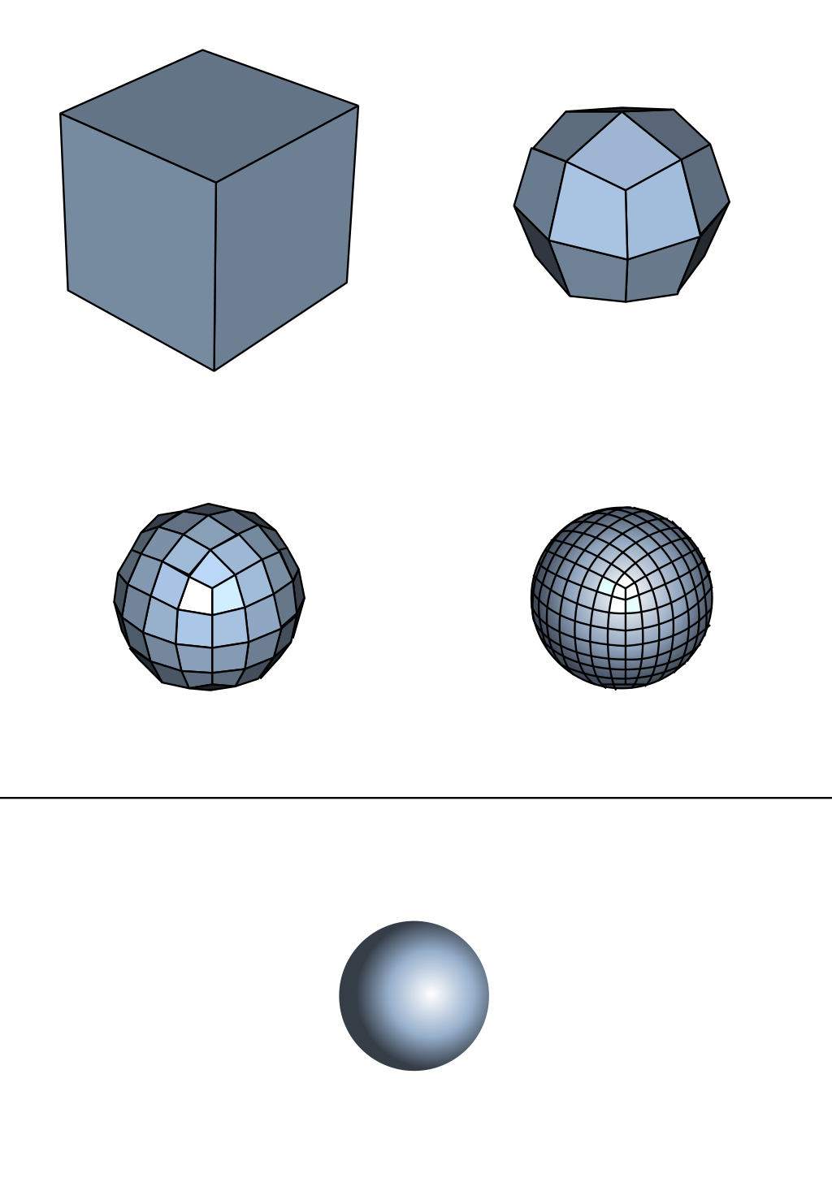
Catmull–Clark algorithm
Notes:
The Catmull–Clark algorithm is a technique used in 3D computer graphics to create curved surfaces by using subdivision surface modeling. It was devised by Edwin Catmull and Jim Clark in 1978 as a generalization of bi-cubic uniform B-spline surfaces to arbitrary topology.^{[1]}

Slide 48
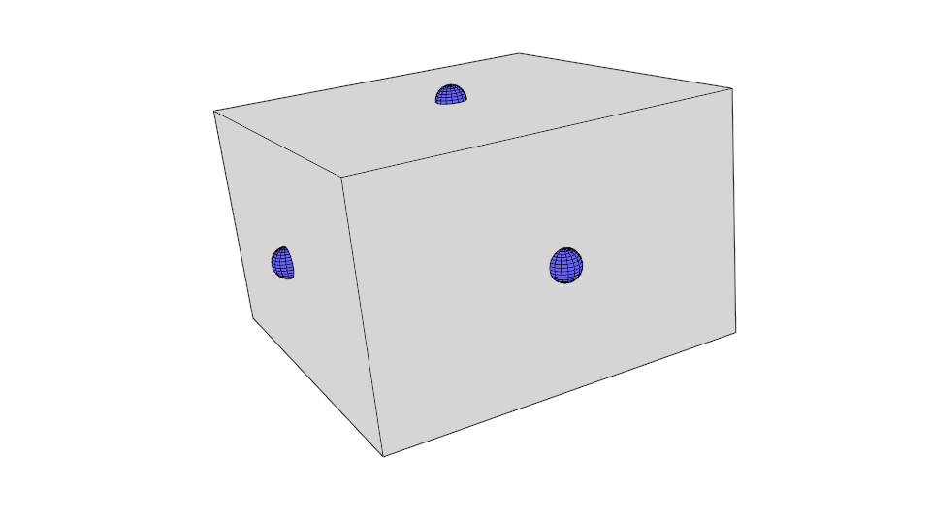
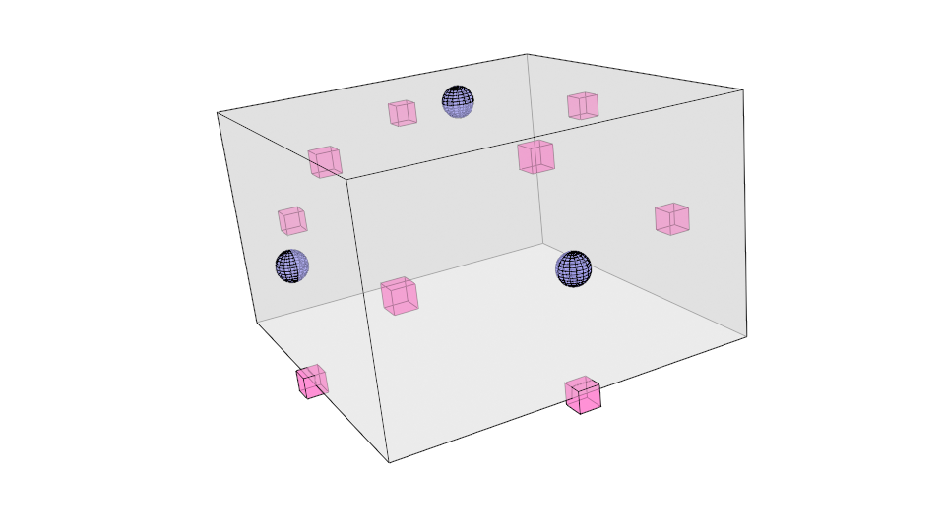
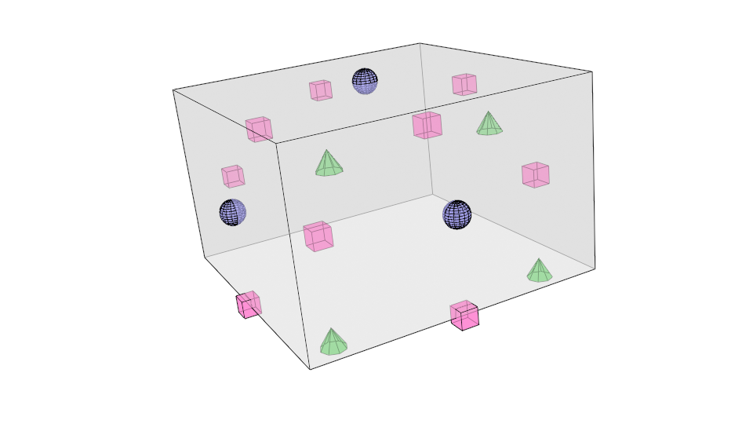
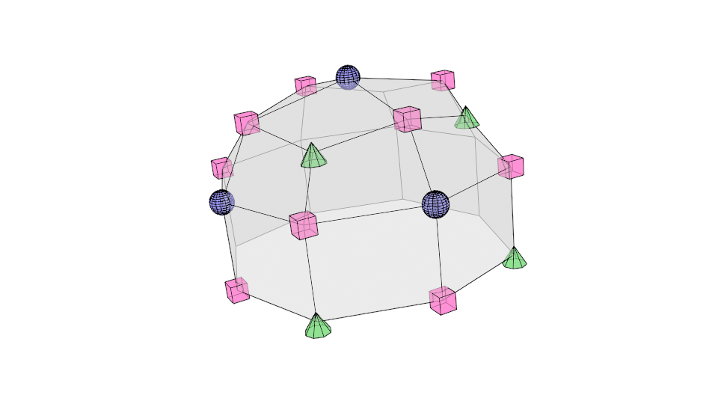
Catmull–Clark algorithm
1. Set each face point to be the average of all original points for the respective face
2. Set each face point to be the average of all original points for the respective face
3. For each original point (P), take the average (F) of all n face points for faces touching P, and take the average (R) of all n edge midpoints for original edges touching P, where each edge midpoint is the average of its two endpoint vertices (not to be confused with new edge points above).
4. Form edges and faces in the new mesh

Slide 49
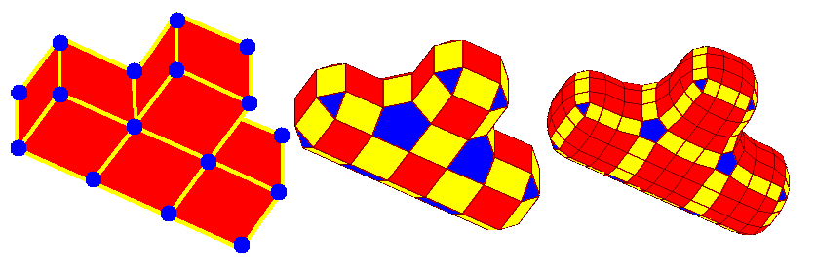
Doo–Sabin subdivision surface

